Slide 1
Time Series: Unit 5
MA and ARMA!

Slide 2
Break Out 1

Slide 3
1. AIC5 for Store 8: Item 1
Review and describe your findings with respect to the AIC and the model identification for the realization you chose.

Slide 4
End Break Out 1

Slide 5
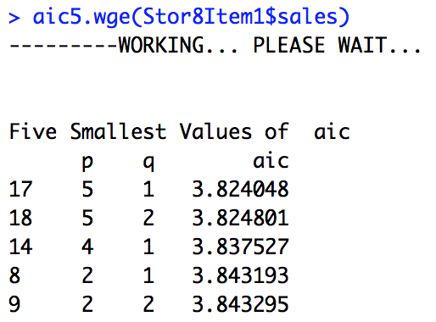
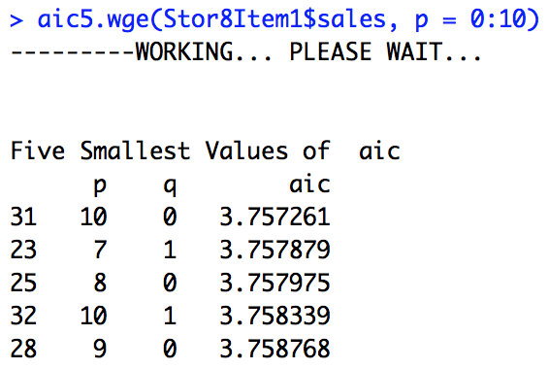
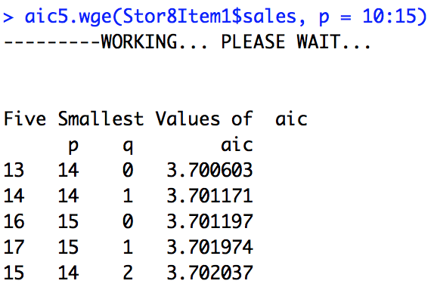
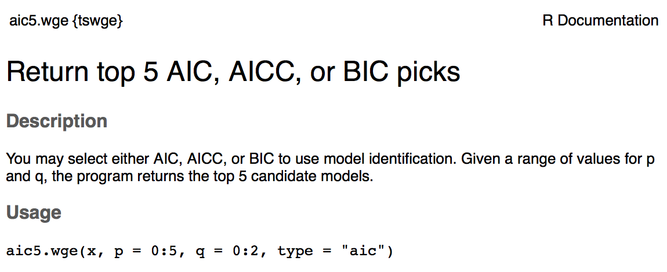
1. AIC5 for Store 8: Item 1

Slide 6
Break Out 2

Slide 7

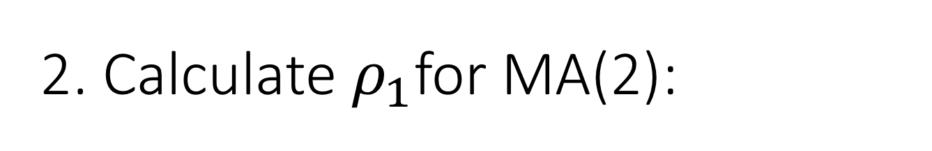
2. Calculate $ρ_{1}$for MA(2):
$$X_{t}=a_{t}−.8a_{t−1}+.5a_{t−2}$$

Slide 8
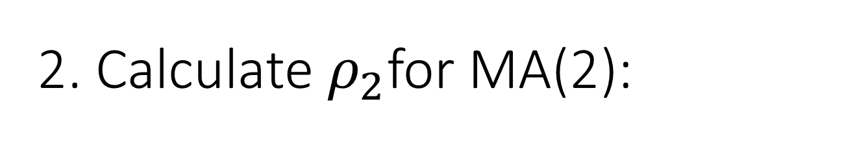
2. Calculate $ρ_{2}$for MA(2):
$$X_{t}=a_{t}−.8a_{t−1}+.5a_{t−2}$$

Slide 9
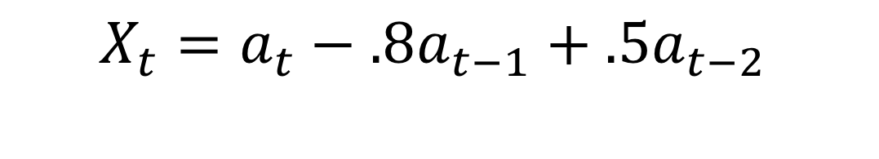
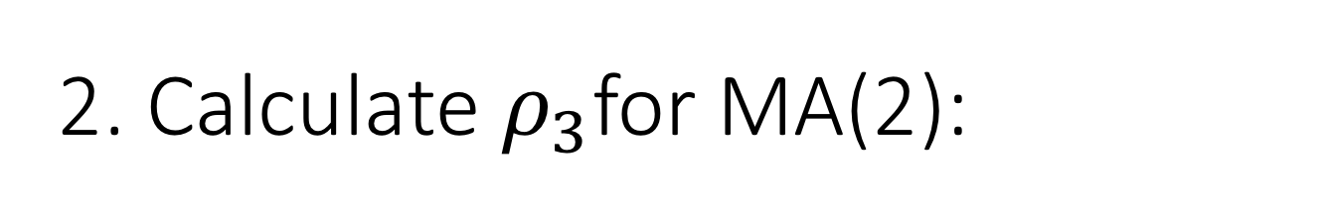
2. Calculate $ρ_{3}$for MA(2):
$$X_{t}=a_{t}−.8a_{t−1}+.5a_{t−2}$$

Slide 10
Verify the autocorrelations using tswge

Slide 11
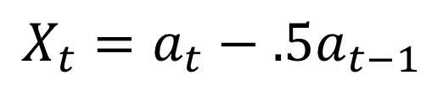
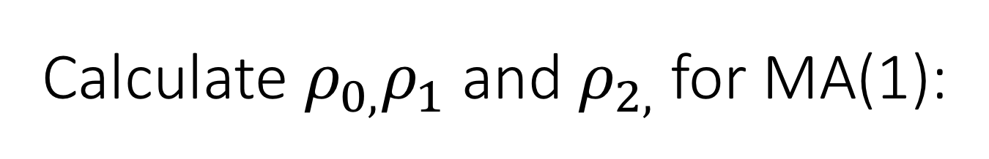
Calculate $ρ_{0,}ρ_{1}$ and $ρ_{2,}$for MA(1):
$$X_{t}=a_{t}−.5a_{t−1}$$
We will use this result a bit later…. maybe write this one down on a scratch sheet of paper.

Slide 12
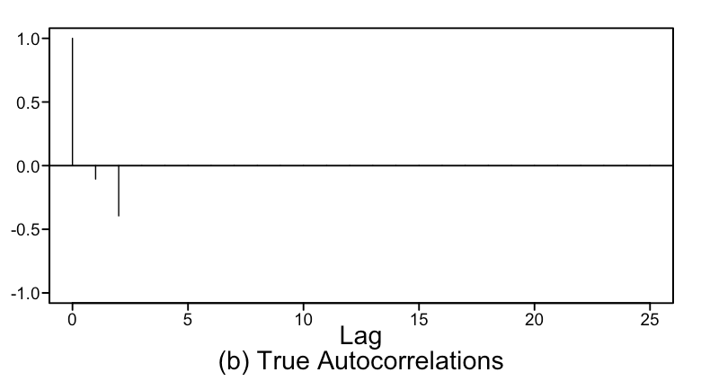
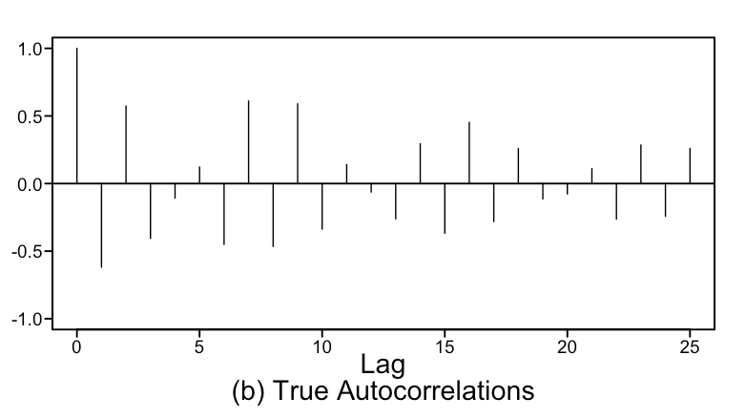
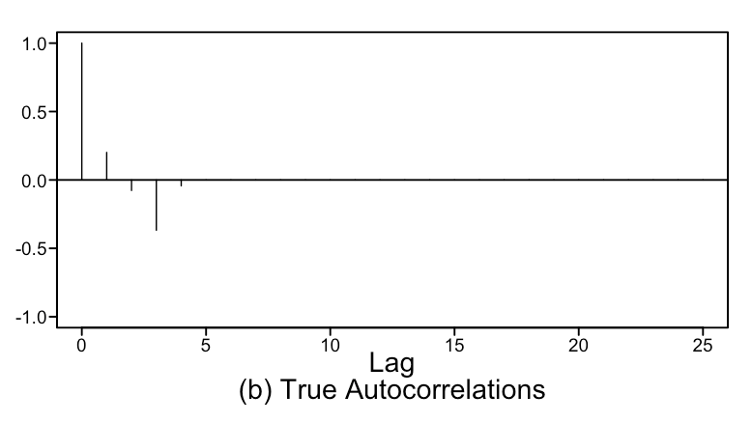
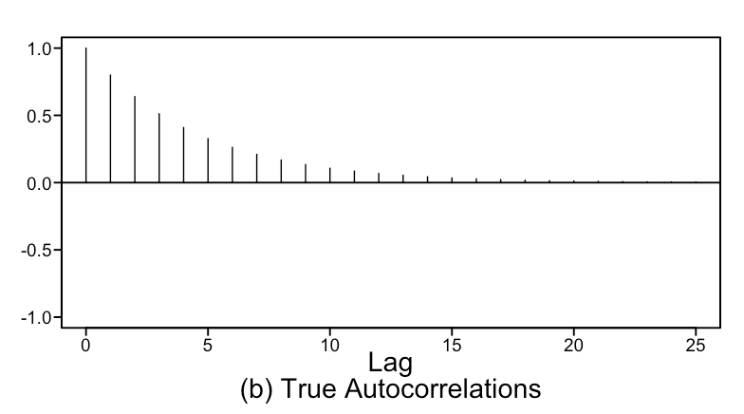
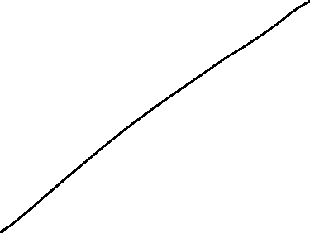
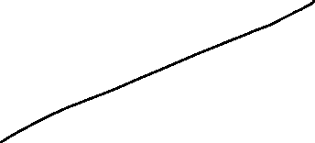

Matching: Without R / tswge
1. AR(1)
a
2. MA(2)
b
3. MA(4)
c
4. AR(4)
d

Slide 13
END Break Out 2

Slide 14
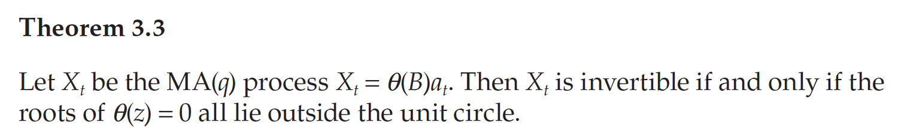
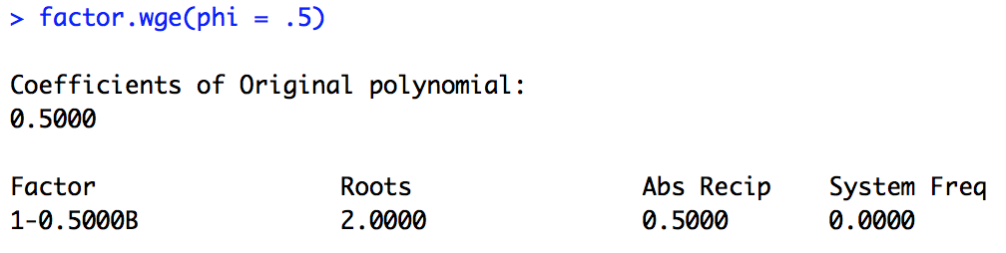
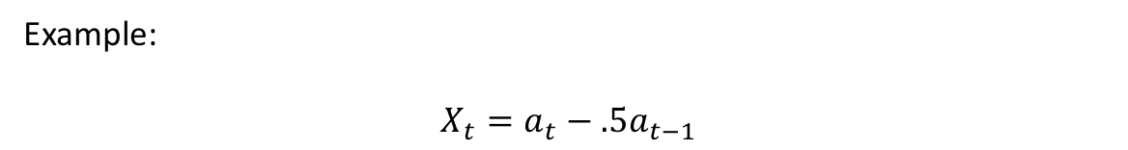
Review Invertible Models
Example:
$$X_{t}=a_{t}−.5a_{t−1}$$

Slide 15
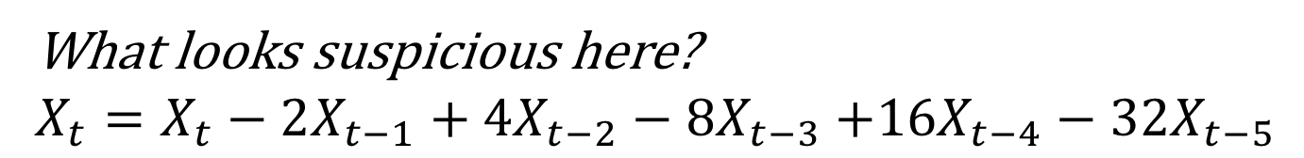
Discussion: Invertibility
What looks suspicious here?
$X_{t}=X_{t}−2X_{t−1}+4X_{t−2}−8X_{t−3}$ $+16X_{t−4}−32X_{t−5}$

Slide 16
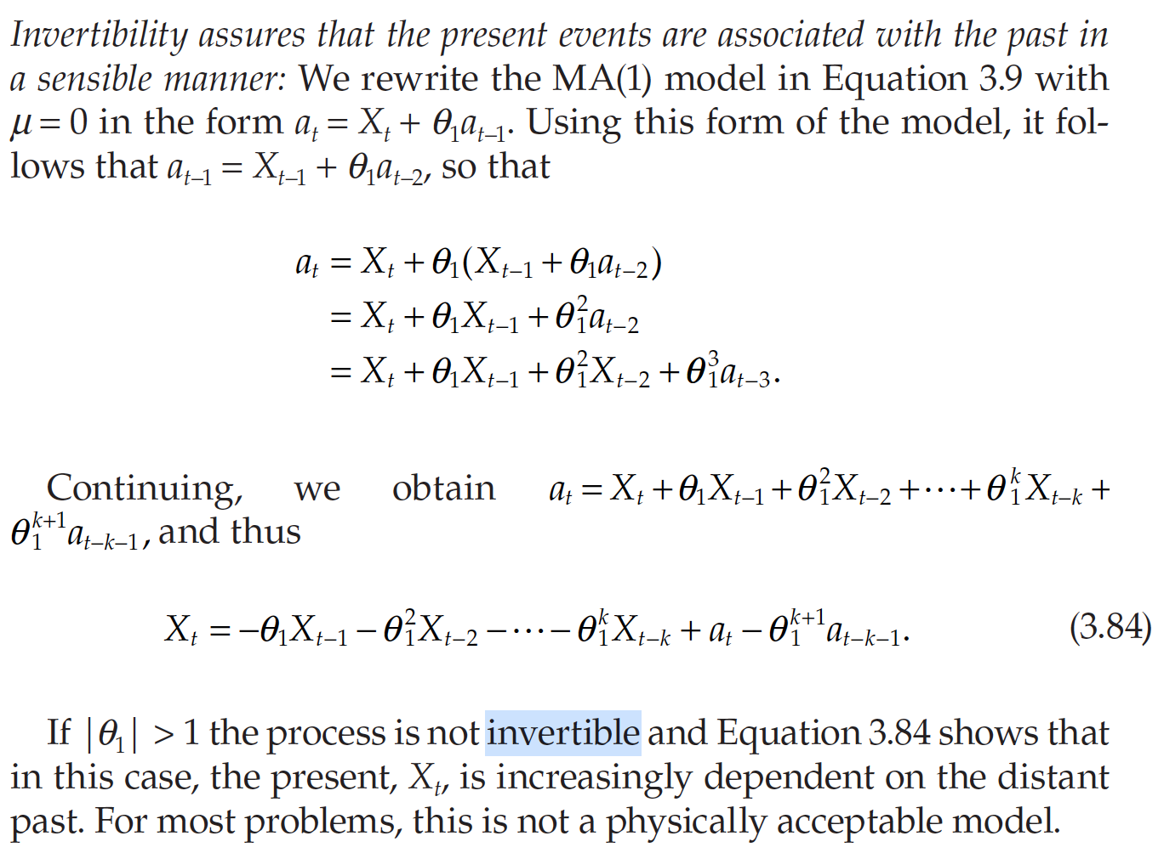
Why Only Consider Invertible Models?
pg. 132

Slide 17
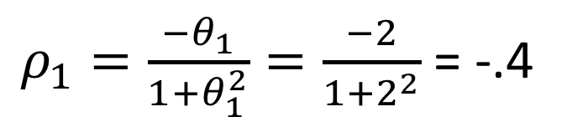
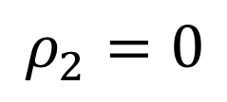
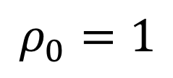
Discussion: Invertibility
What are the autocorrelations of : $X_{t}=a_{t}−2X_{t−1}$
$$ρ_{0}=1$$
$ρ_{1}=\frac{{−θ}_{1}}{1+θ_{1}^{2}}=\frac{−2}{1+2^{2}}$ = -.4
$$ρ_{2}=0$$

Slide 18
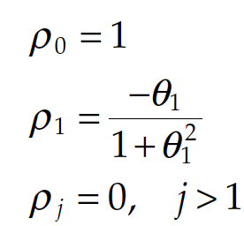
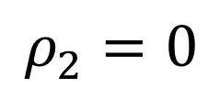
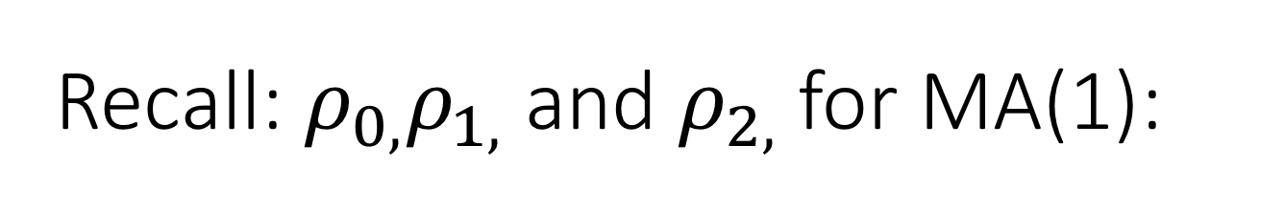
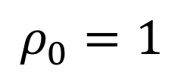
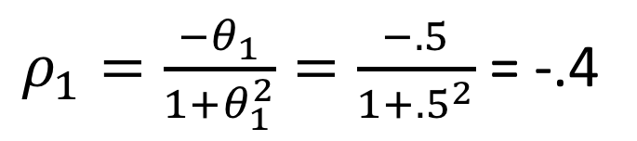
Recall: $ρ_{0,}ρ_{1,}$ and $ρ_{2,}$for MA(1):
$$X_{t}=a_{t}−.5a_{t−1}$$
$$ρ_{0}=1$$
$ρ_{1}=\frac{{−θ}_{1}}{1+θ_{1}^{2}}=\frac{−.5}{1+{.5}^{2}}$ = -.4
$$ρ_{2}=0$$
We will use this result a bit later…. maybe write this one down on a scratch sheet of paper.

Slide 19
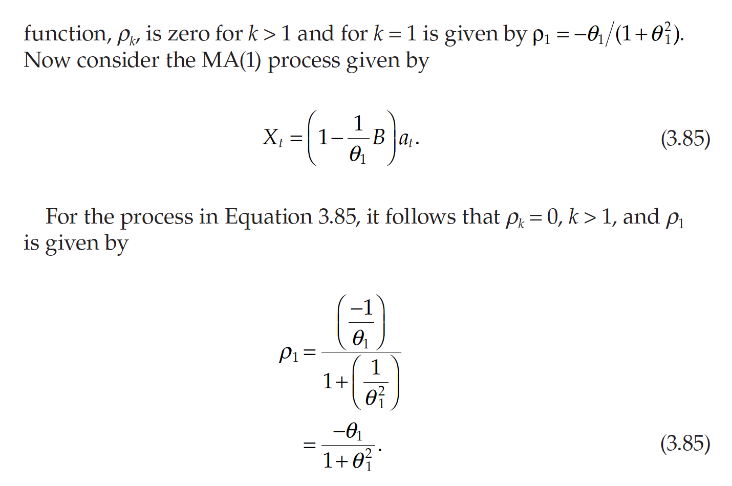
Why Only Consider Invertible Models?
pg. 132

Slide 20
Break Out 3

Slide 21
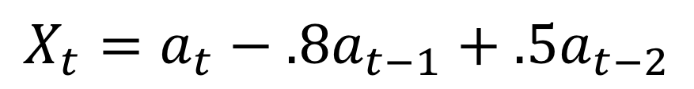
GLP Form for MA(2)
$$X_{t}=a_{t}−.8a_{t−1}+.5a_{t−2}$$

Slide 22

GLP Form for AR(2)
$$X_{t}−.8X_{t−1}+.5X_{t−2}=a_{t}$$

Slide 23
GLP Form for ARMA(2,2)
$$X_{t}−.8X_{t−1}+.5X_{t−2}=a_{t}−.4a_{t−1}+.9a_{t−2}$$

Slide 24
End Break Out 3

Slide 25
Break Out 4

Slide 26
ARMA MODELS
Compare and discuss the realizations from the ARMA model(s) you generated. Specifically comment and compare the ACFs and the Spectral Densities.

Slide 27
Evaluate AIC for identifying model structure.
Generate 100 observations from an ARMA(1,1).
Use aic5.wge() to try and identify the model.
Now generate 500 observations from an ARMA(1,1)
use aic5.wge()to try and identify the model
How does aic5.wge() perform?
Repeat for an ARMA(p,q) where you select the p and q.

Slide 28
End Break Out 4

Slide 29
Break Out 5

Slide 30
SWA Cancellation Data
Discuss which of the 5 models from aic5.wge() you would favor most for this realization?

Slide 31
End Break Out 5

Slide 32
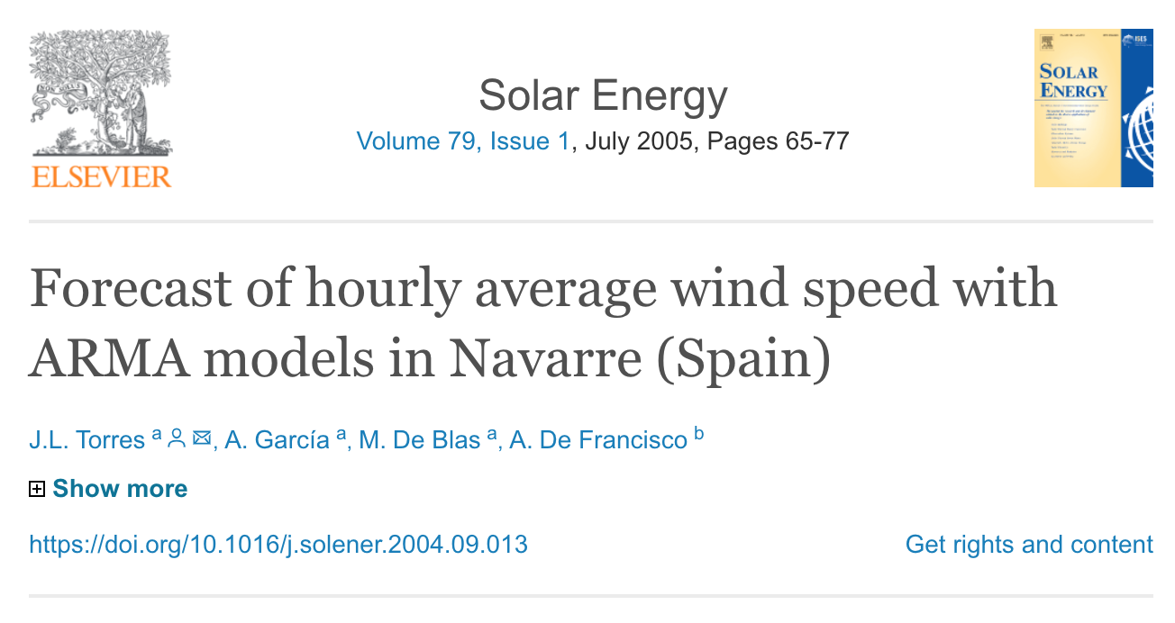
Time Series Study!

